Slide 1
ADA Advisory Group Meeting #2
Tuesday, December 8, 2020
4:00-5:00pm
Notes:
Missing curb ramps at crosswalks in residential neighborhood of Sedro-Woolley at northwest corner of State and Township (near bus stop at Township and State).

Slide 2
Agenda
Virtual Workshop Debrief
2020 ADA Barrier Online Survey Findings
Current Activities Update
Public Comments
Next AAG Meeting

Slide 3
Virtual Workshop Debrief
2 participants not affiliated with Project Team staff or AAG
Barrier locations provided:
Mobile Park and Carriage Court: problematic sidewalks and curb ramps
Highway 9 north of SR-20: curb ramps without tactile pads
Ferry Street near the old Heritage Bank: tree roots on south side of Ferry at Puget Street
State and Township: missing curb ramps and pedestrian crossings
Bennett Street: uneven sidewalks

Slide 4
Online Surveys
28 Responses
Survey Monkey (25)
Survey123 (3)
General Observations
Trail design
Maintenance/obstacle clearing
Traffic signal phasing/timing
Sidewalk barriers: cracks, lack of ramps, lack of sidewalks
Barriers in the vicinity of schools
Communication and employment

Slide 5
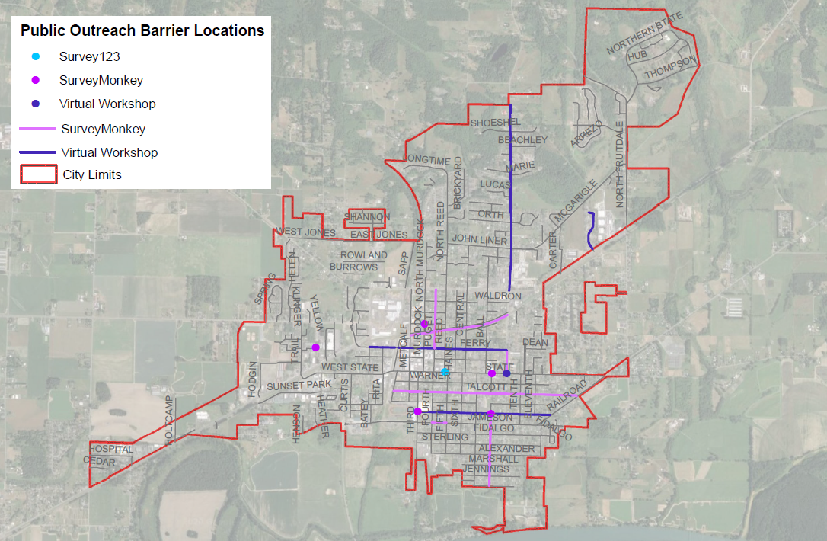
Public Outreach Barrier Locations map

Slide 6
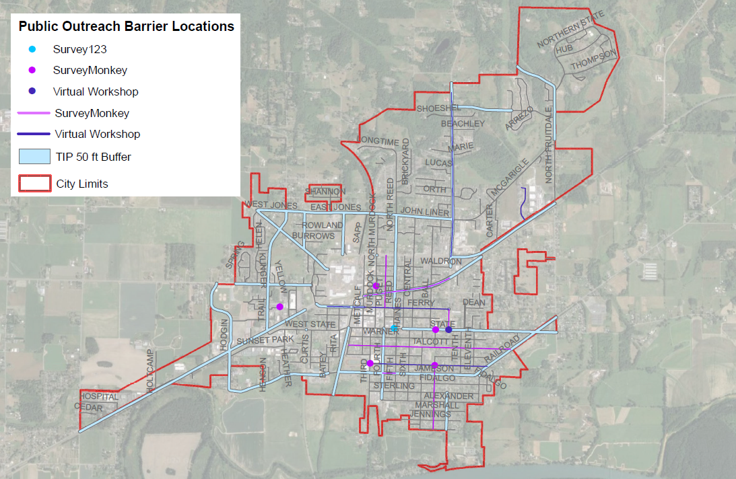
Public Outreach Barrier locations map with Fifty Foot TIP buffer.

Slide 7
Top Priority Barrier Types – Ranked Comparison
Rank | SurveyMonkey (23 responses) | Score | Rank | ArcGIS Survey123 (3 responses) | Score
1 | Fixed Objects Blocking Path of Travel, Overgrown Vegetation in Path of Travel, Sidewalk Cracks/Bumps | 4 | 1 | Missing Pedestrian Crossings | 5.5
2 | Missing Curb Ramps | 3.86 | 2 | Missing Accessible Pedestrian Signals | 4.5
3 | Missing Accessible Pedestrian Signals | 2.57 | 3 | Missing Curb Ramps | 3.5
4 | Missing Pedestrian Crossings | 2.55 | 4 | Sidewalk Cracks/Bumps | 3
5 |  |  | 5 | Fixed Objects Blocking Path of Travel | 3
6 |  |  | 6 | Overgrown Vegetation in Path of Travel | 1.5

Slide 8
Top Priority Locations – Ranked Comparison
Rank | SurveyMonkey (22 responses) | Score | Rank | ArcGIS Survey123 (3 responses) | Score
1 | Grocery Stores/Retail Shopping Centers | 5.09 | 1 | Schools/Libraries | 6
2 | Transit Centers/Stops/Routes | 4.81 | 2 | Senior Center/Elderly Care Facilities | 5.5
3 | Senior Center/Elderly Care Facilities | 4.64 | 3 | Grocery Stores/Retail Shopping Centers | 5
4 | Schools/Libraries | 4.33 | 4 | Transit Centers/Stops/Routes | 4.5
5 | Local Government Buildings/Post Offices | 3.71 | 5 | Local Government Buildings/Post Offices, Parks/Trails | 3
6 | Parks/Trails | 3.45 | 6 | My residence | 1.5
7 | My residence | 1.86 | 7

Slide 9
Key Takeaways
Barriers identified were primarily in area south of SR-20 in residential areas
Narrative responses identified barriers in proximity to schools
State and Township intersection barriers identified by respondents on both surveys and virtual workshop

Slide 10
Current Activities
Building Facilities Evaluations
Parks and Trails Evaluations

Slide 11
Public Comments

Slide 12
Next Meeting
Tuesday, January 12, 2020 at 4pm via Zoom

